Slide 1
NAME:ATUHAIRE PAULINE
REG NO:B35093
COURSE:DATA LIFE CYCLE

Slide 2
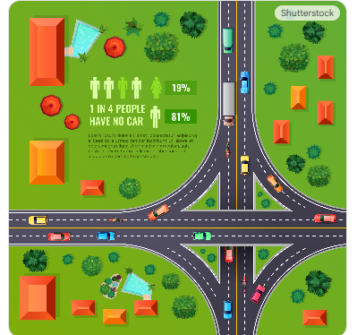
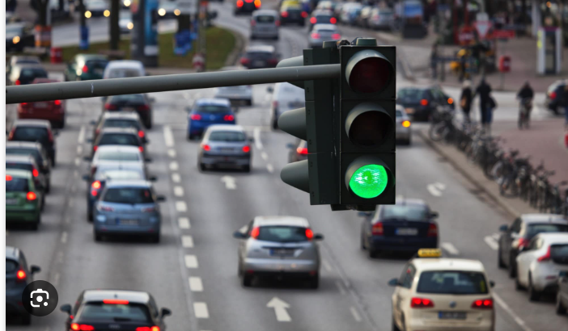
DEEP GREEN
Deep Green: Is an autonomous traffic control system powered by Deep Reinforcement Learning
The Problem(The Why)
Congestion costs billions annually
Current solution: Fixed timers (inefficient) or expensive sensors (hard to maintain).
Goal: An agent that sees traffic and adapts instantly.

Slide 3
Comparison of Rule-Based Control(If X then Y) Vs Trial and Error(Optimal Policy)
Feature | Rule-Based Control | RL Control
Knowledge Source | Human expertise, explicit rules | Data from interaction, trial & error
Adaptability | Low; rules must be manually updated for new situations | High; learns and adapts to changing environments over time
Complexity | Suitable for simple, well-defined problems | Suitable for complex, dynamic problems where rules are hard to define
Decision Process | Follows deterministic "If X then Y" logic | Learns a "policy" that maximizes long-term reward

Slide 4
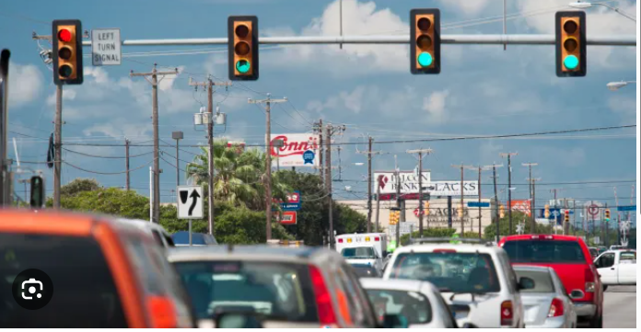
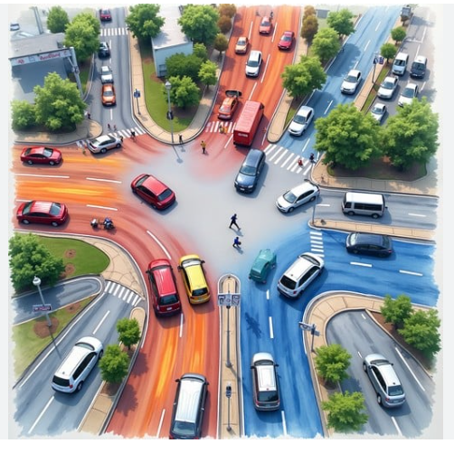
Illustration of Rule-Based Control(If X then Y) Vs Trial and Error(Optimal Policy)
Traditional coding requires us to write rules for every possible traffic scenario. RL allows the agent to learn the rules by interacting with the traffic itself, finding optimizations humans might miss

Slide 5
Mathematical Formulation (The MDP)
➢ State ($S$): Agent's Perception. Snapshot of the intersection traffic condition (queue lengths, vehicle speeds) used as input for decision-making.
➢ Action ($A$): Agent's Control. Discrete choice to either Switch the light phase (e.g., North-South $\to$ Yellow/Red $\to$ East-West) or Keep the current phase.
➢ Reward ($R$): Agent's Goal. Negative value of the total waiting time. The agent maximizes reward by minimizing delay and congestion.
Note: This is the core of the research. We punish the agent for every second a car sits idle. To maximize its score, it must clear traffic efficiently."

Slide 6
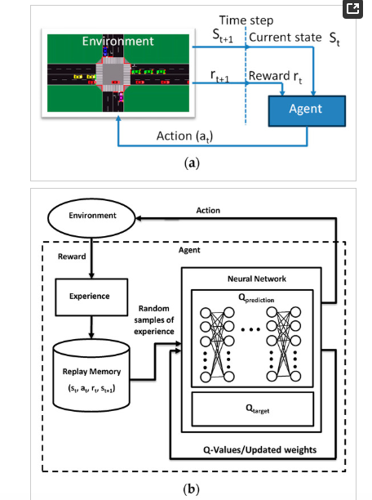
Mathematical Formulation (The MDP) Illustration

Slide 7

The Solution: Deep Q-Network (DQN)
Key Concepts:
Experience Replay: Remembering past traffic jams to learn from them later.
Exploration: Occasionally trying random phases to discover new strategies.
I chose DQN because traffic phases are discrete choices. The 'Brain' is a deep neural network that predicts the long-term value of turning the light green right now.
Q-Function Approximation: Instead of using a table to store Q-values for each state-action pair, DQN uses a neural network to approximate the Q-values. The input to the network is the state, and the output is a set of Q-values for all possible actions.
Bellman Equation:
Where:
θ are the weights of the main Q-network,
θ− are the weights of the target Q-network,
s is the current state,
a is the action taken,
ris the reward received,
s′ is the next state,
maxa′Q​Q’(s′,a′) is the maximum Q-value for the next state.

Slide 8
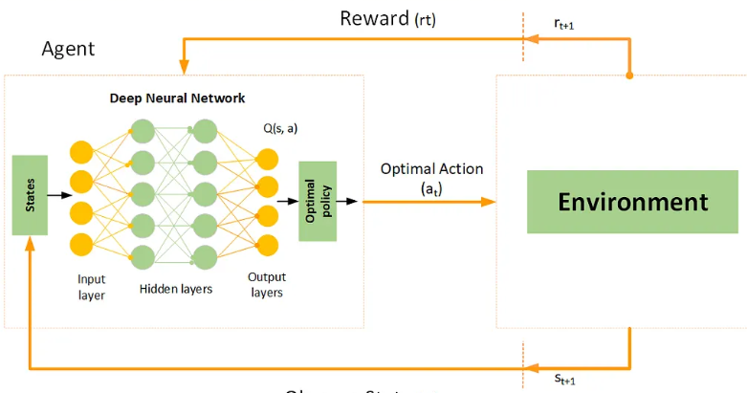
Schematic Illustration

Slide 9
Simulation Environment
We will use highway-env for training. It's lightweight, standardizes the observation space, and allows for rapid iteration before we test on heavier simulators like SUMO."
Env: Gymnasium intersection-v1.
Input: Vector of lane density.
Output: Phase change command.
Note: I shall use highway-env for the training. It's lightweight, standardizes the observation space, and allows for rapid iteration before we test on heavier simulators like SUMO.“
SUMO: Simulation of Urban Mobility (SUMO) is an open-source microscopic traffic simulation package for modeling and analyzing transportation systems.

Slide 10
Implementation Plan (Part B Preview)
Phases
Weeks 1-2: Environment setup and Baseline (random agent).
Weeks 3-5: Training DQN and Hyperparameter tuning.
Weeks 6-7: Deployment (Dockerizing the model and building a Flask API).
Note: My goal isn't just a model, it's a deployable artifact. I will containerize the final agent so it can accept traffic data via API and return signal decisions.

Slide 11
Evaluation and Success Metrics
Primary Metric: Average Waiting Time
Goal: Reduce average waiting time per vehicle to less than 20 seconds.
Success Target: At least a 15% reduction compared to a fixed-timer baseline.
Secondary Metrics:
Intersection Throughput: Increase the number of vehicles successfully clearing the intersection per hour.
Queue Length / Overflows: Minimize maximum queue lengths to prevent gridlock.
Training Performance:
Convergence Speed: Demonstrate that the agent's reward learning curve becomes stable within a reasonable number of training episodes/timesteps (e.g., after ~20,000-50,000 steps).
MLOps Monitoring:
Model Drift: Monitor if the deployed agent's performance degrades over time in a live/simulated production setting.
Data Drift: Track changes in input traffic patterns to detect conditions that might invalidate the model.

Slide 12
Comparison Chart for Traffic Fixed Timer and RL Matrix

